Slide 1
SAVALIYA MEET
ESIT Presentation

Slide 2
HTML

Slide 3
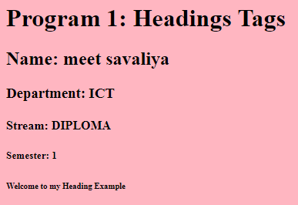

Slide 4
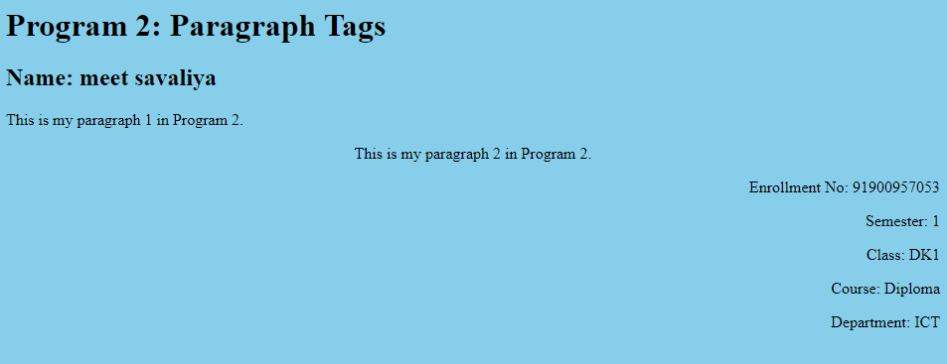

Slide 5
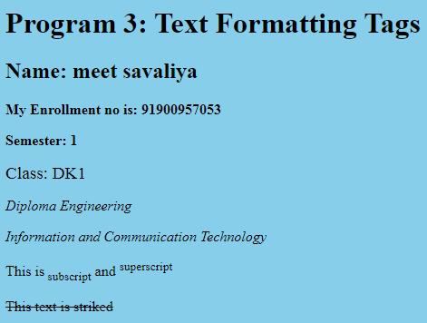

Slide 6


Slide 7
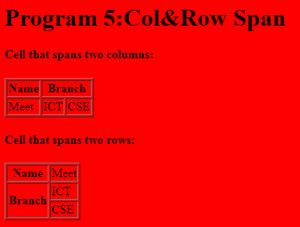

Slide 8
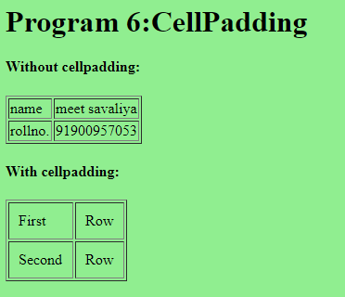

Slide 9
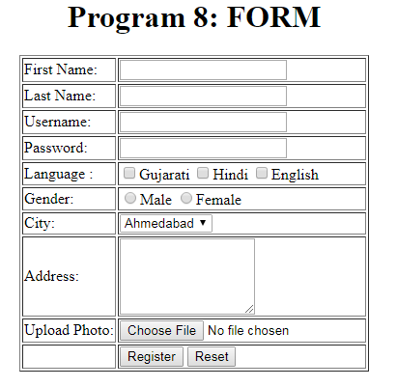

Slide 10
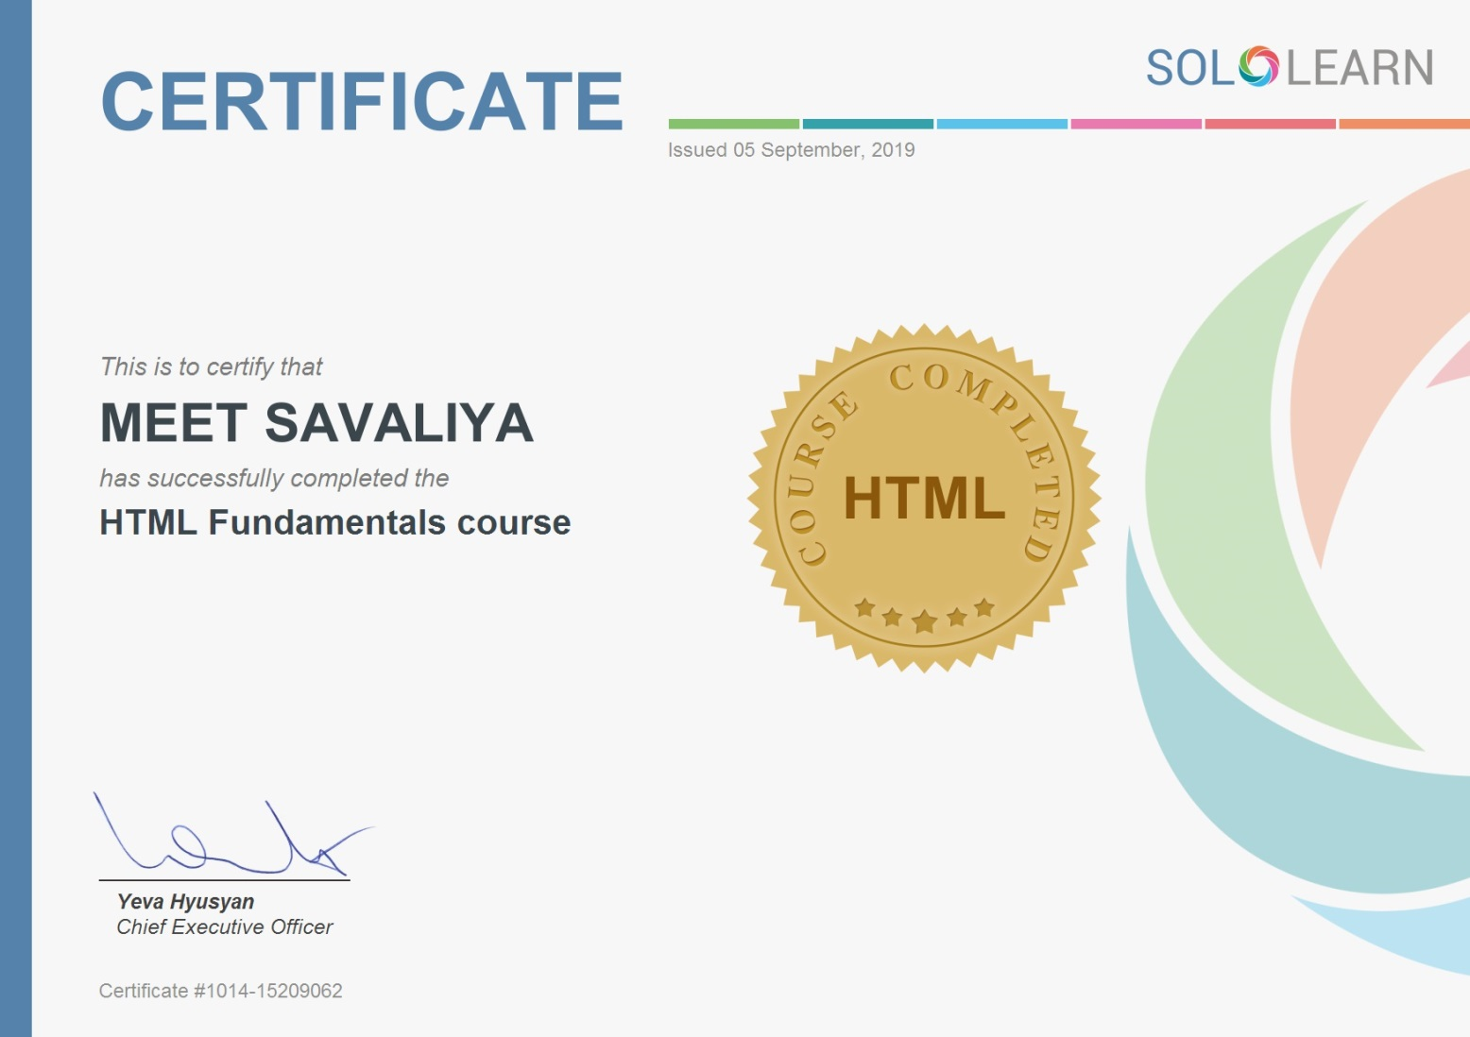

Slide 11
CSS

Slide 12
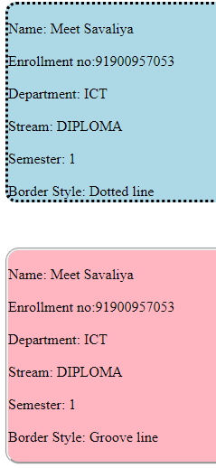
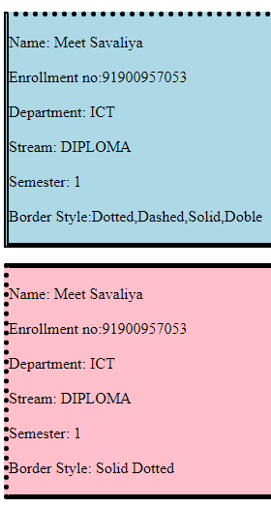
CSS Borders

Slide 13
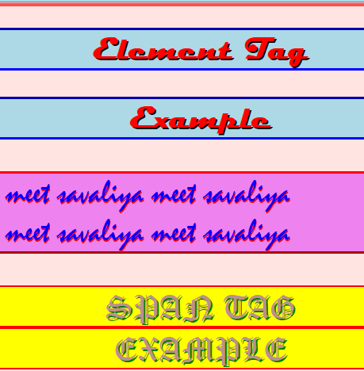
CSS SELECTORS

Slide 14


CSS Text And Font

Slide 15
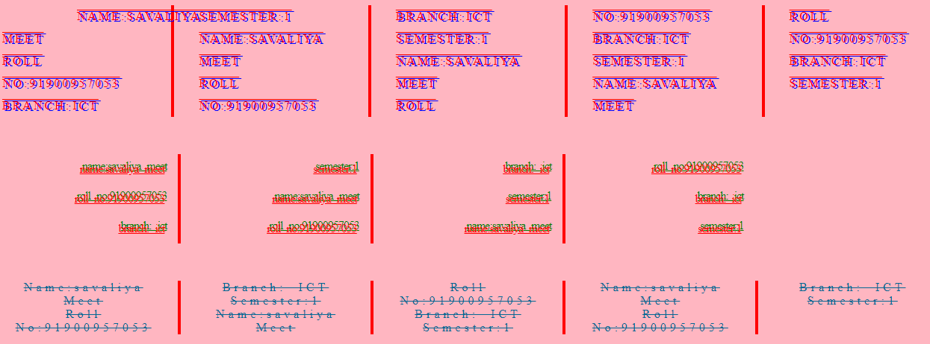
CSS Column

Slide 16


Slide 17
JavaScript

Slide 18
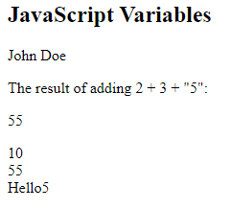
JavaScript Variables

Slide 19


JavaScript Odd Even Example

Slide 20


check lowest number

Slide 21


